Slide 1
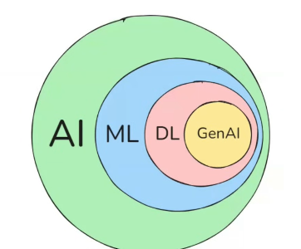

π
Neural Network
Neural network & History
Neural Network –How it works
Component of Neural network
Activation Function
Backward error propagation
Time Series Data
ANN,CNN,RNN
ANN
Neural Network-Layman term
RNN
Type of RNN
Problem with RNN
LSTM
Notes:
Content: https://www.linkedin.com/pulse/chunking-strategies-ai-data-kash-kashyap-0lghe/

Slide 2
1
2
3
Gradient Descent
Loss /Cost Function
Time Series
Relu
TanH
Vanishing Gradient Problem
Learning Rate
Sigmoid
feed forward NN

Slide 3
Time Series Data
If any data is changing every seconds. If we recorded or collected that data over a time, These data are called time series data
Stock price
Daily Temperature Reading
Heart Rate
IOT - Sensor reading Data
Notes:
Content: https://www.linkedin.com/pulse/chunking-strategies-ai-data-kash-kashyap-0lghe/

